Slide 1
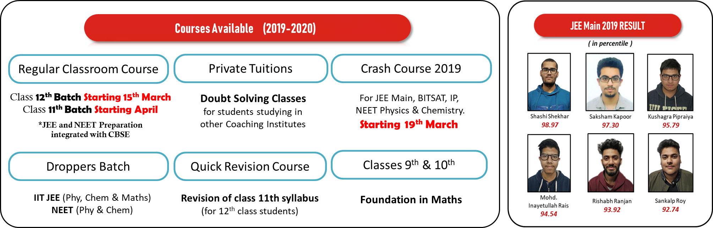

Slide 2
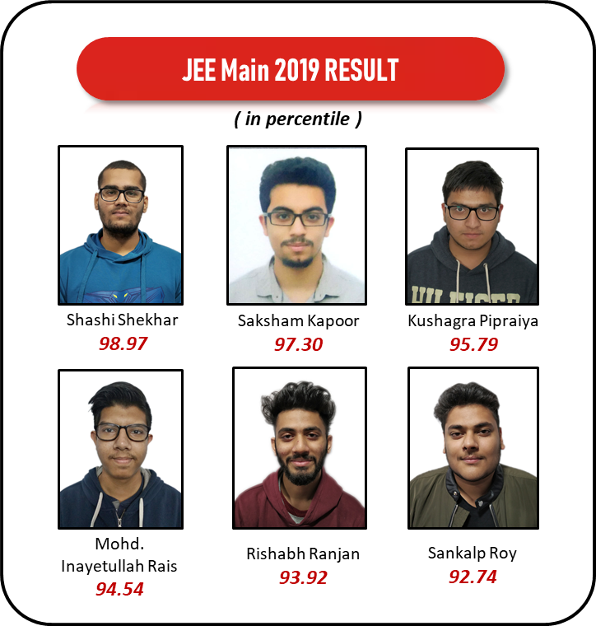
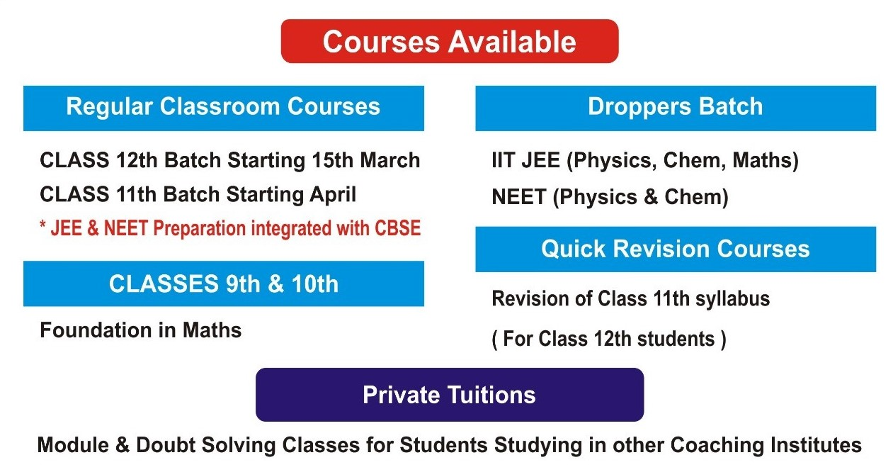
Courses Available (2019-2020)
Regular Classroom Course
Private Tuitions
Crash Course 2019
Class 12th Batch Starting 15th March
Class 11th Batch Starting April
*JEE and NEET Preparation
integrated with CBSE
Doubt Solving Classes
for students studying in
other Coaching Institutes
For JEE Main, BITSAT, IP,
NEET Physics & Chemistry.
Starting 19th March
Droppers Batch
Quick Revision Course
Classes 9th & 10th
IIT JEE (Phy, Chem & Maths)
NEET (Phy & Chem)
Revision of class 11th syllabus
(for 12th class students)
Foundation in Maths

Slide 3
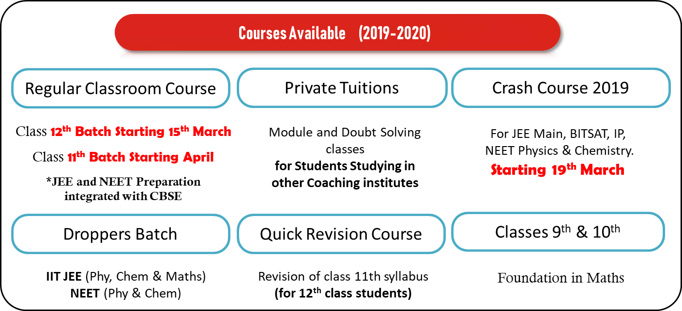
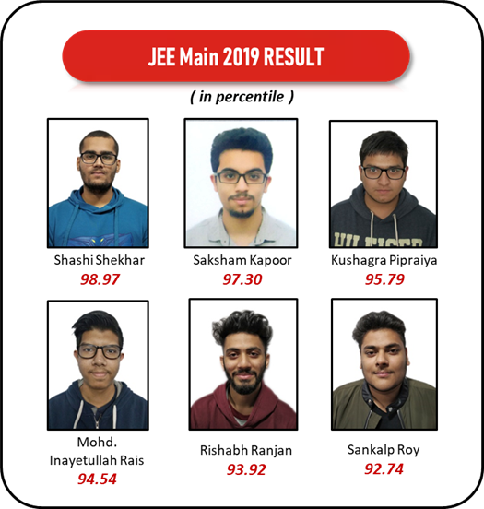

Slide 4
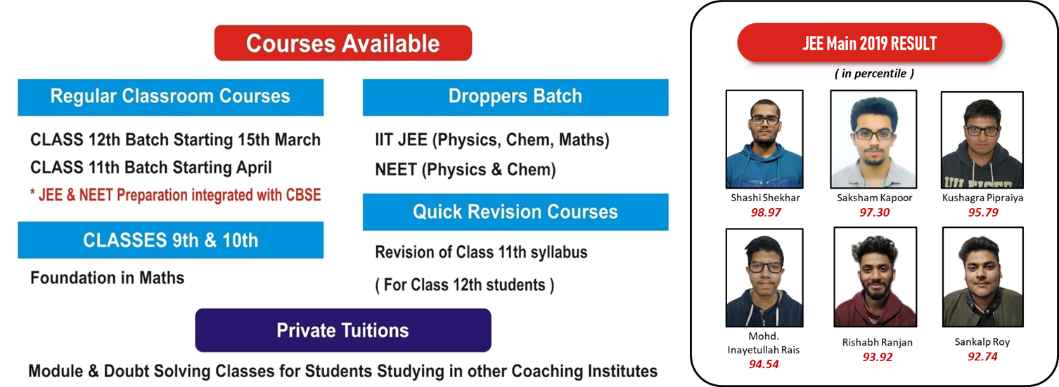

Slide 5
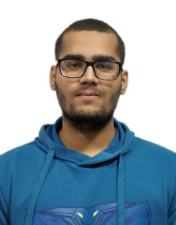
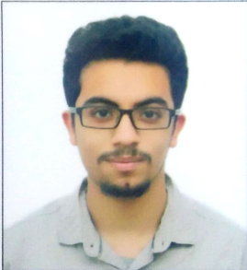
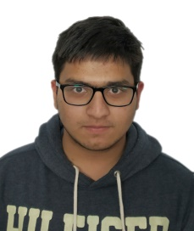
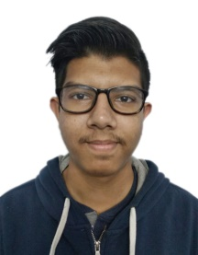
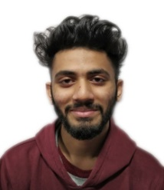

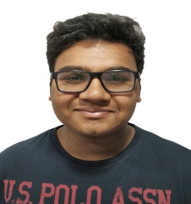
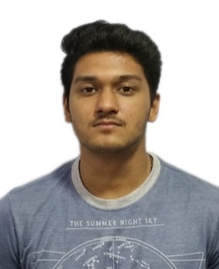
JEE Main 2019 RESULT
( in percentile )
Shashi Shekhar
98.97
Saksham Kapoor
97.30
Kushagra Pipraiya
95.79
Mohd. Inayetullah Rais
94.54
Rishabh Ranjan
93.92
Sankalp Roy
92.74
Stubh Lal
92.16
Uditansh Bhandari
90.89

Slide 6
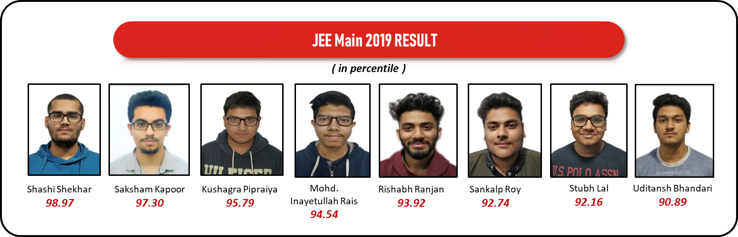

Slide 7


Slide 8
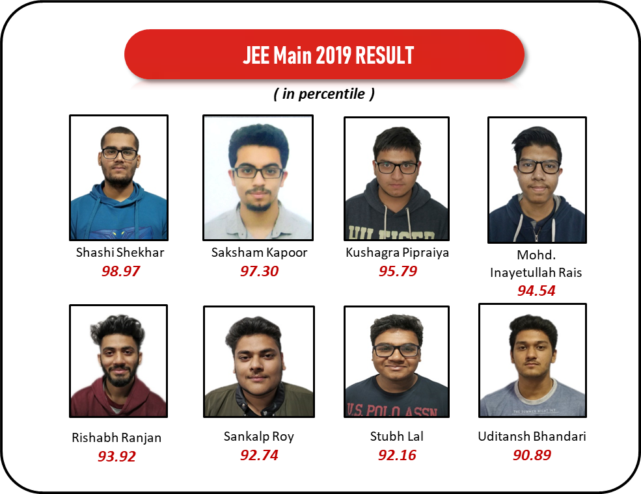

Slide 9

MATHEMATICS
REVISION VIDEOS

Slide 10
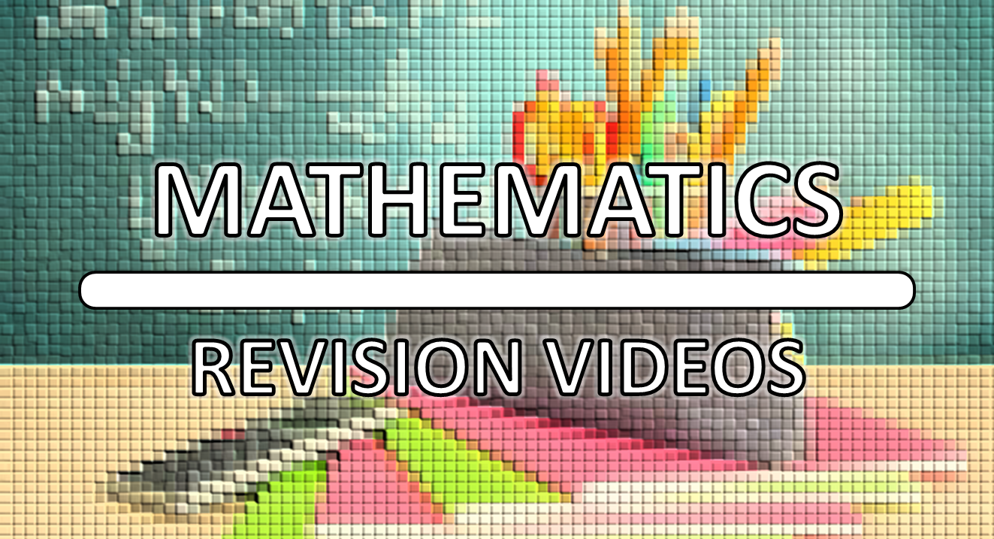

Slide 11

MATHEMATICS
REVISION VIDEOS

Slide 12
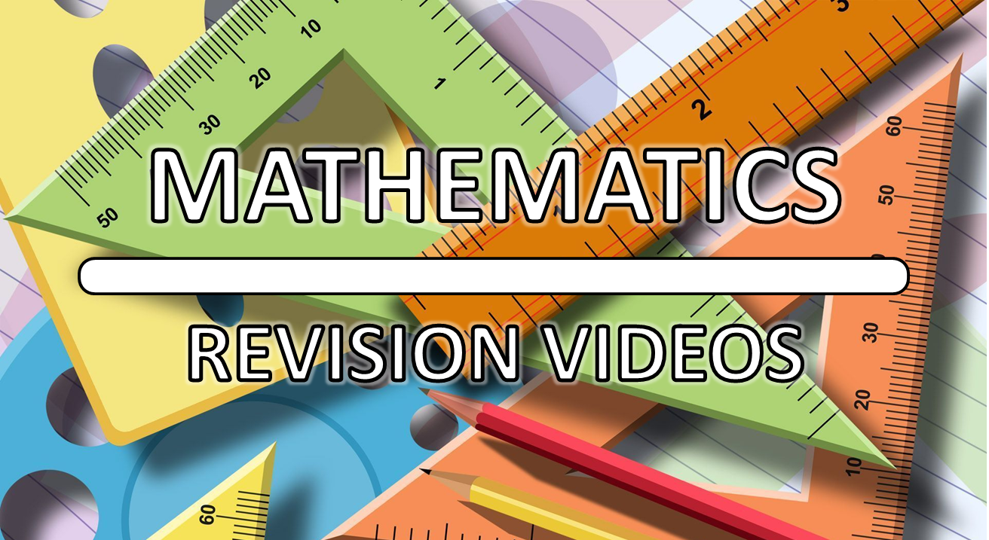

Slide 13
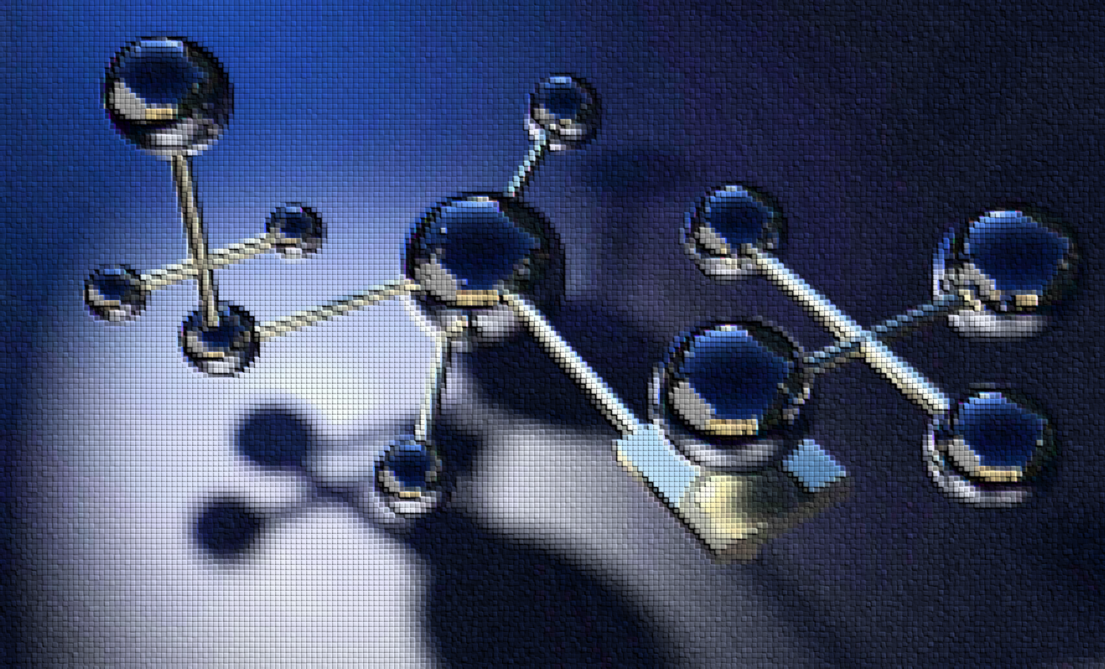
CHEMISTRY
REVISION VIDEOS

Slide 14
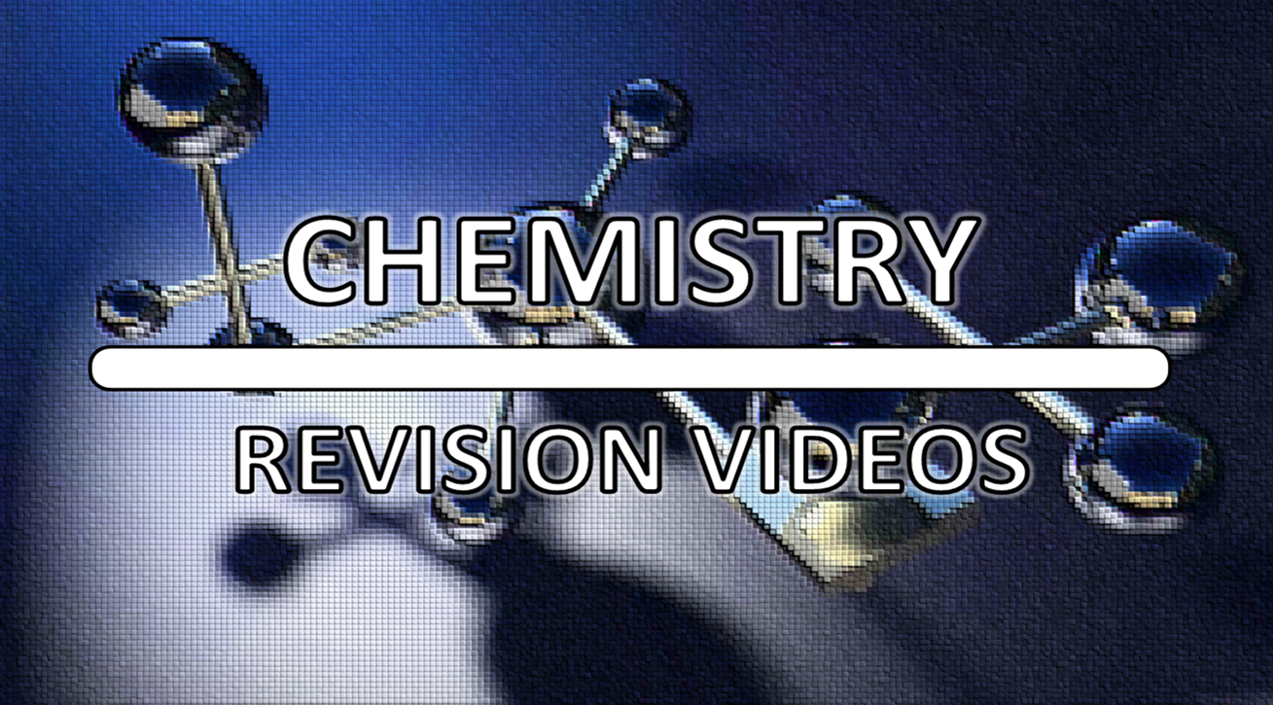

Slide 15
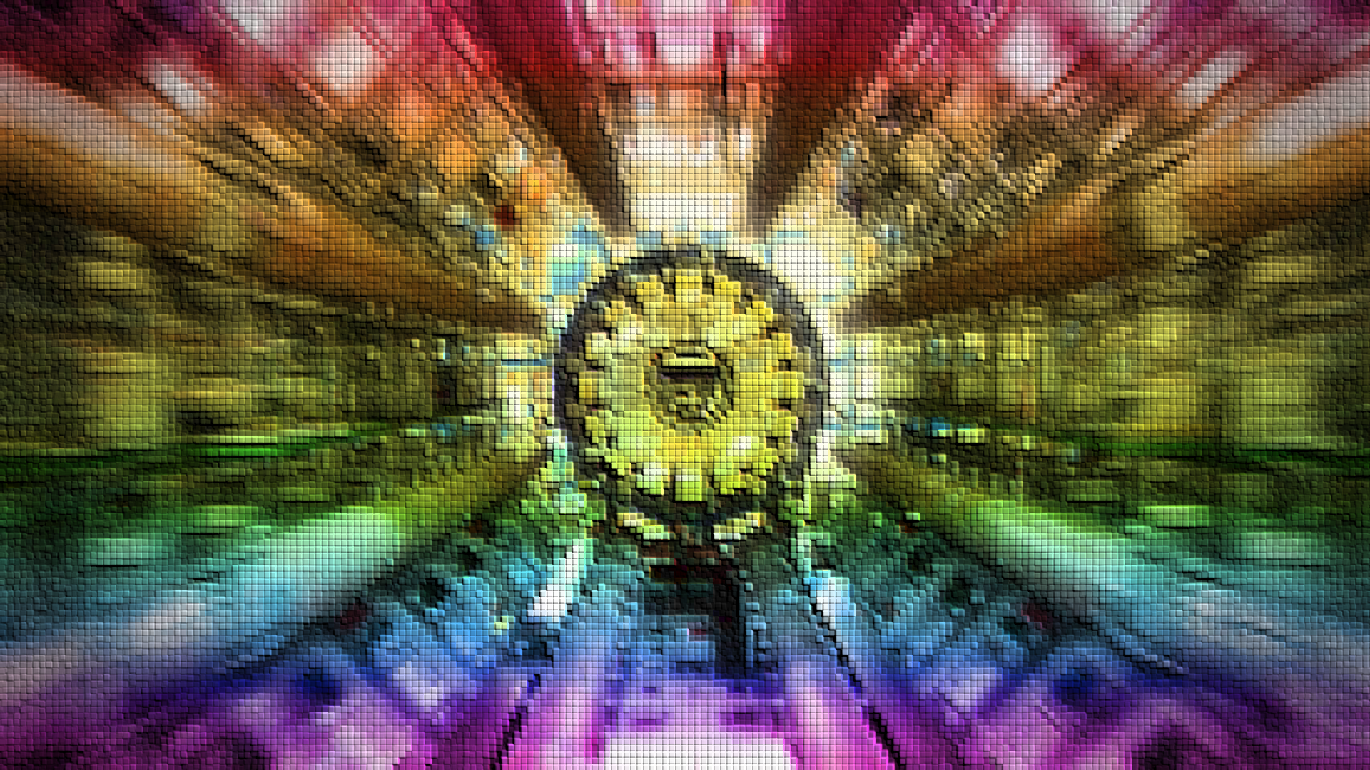
PHYSICS
REVISION VIDEOS

Slide 16
